Slide 1

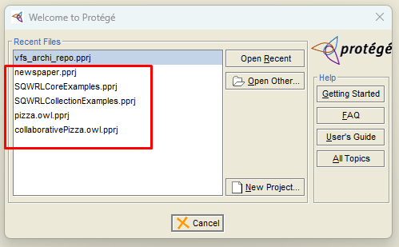
Essential EA Tip: Clean Up Historical Project
For Essential Open Source edition
Config file under Protégé_3.5
protege.properties
In Windows, edit with Administrator permission

